Slide 1
Ensemble Methods
Tim Pengajaran
Mata Kuliah Machine Learning
Jurusan Teknologi Informasi Tahun 2021

Slide 2
Disclaimer
This presentation material, including examples, images, references are provided for informational and explanation assistance only
The names of actual products and companies mentioned here in, if any, may be the trademarks of their respective owners
Credits shall be given to the images taken from the open-source and cannot be used for promotional activities

Slide 3
Outline Ensemble Methods
What is Ensemble Methods?
Bagging and Random Forest
Boosting and AdaBoost
Stacking

Slide 4
What is Ensemble Methods?
A combination of estimators that performs better than each of its components.
A machine learning technique that combines several base models in order to produce one optimal predictive model.
Techniques that create multiple models and then combine them to produce improved results, usually produces more accurate solutions than a single model would.
A technique to combine the predictions of several base estimators built with a given learning algorithm in order to improve generalizability / robustness over a single estimator.
The art of combining diverse set of learners (individual models) together to improvise on the stability and predictive power of the model.

Slide 5
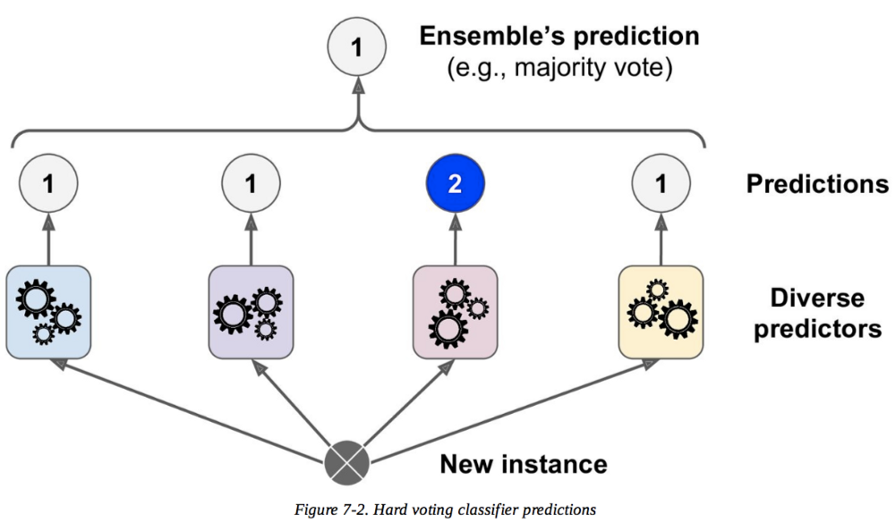
What is Ensemble Methods?

Slide 6
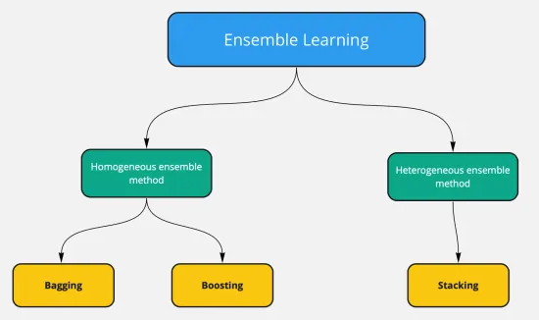
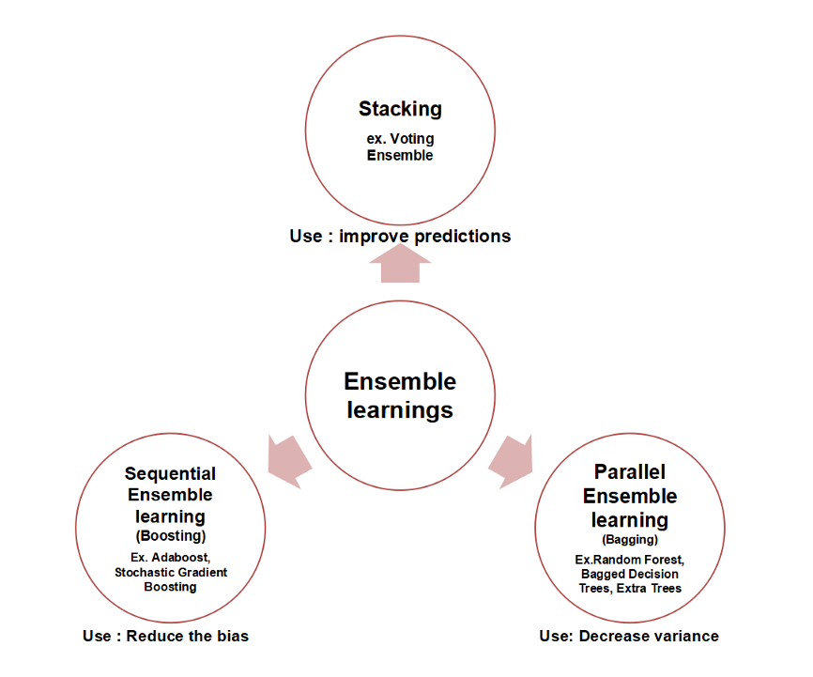
Types of Ensemble Methods

Slide 7
Bagging – Boostrap Aggregating
An ensemble meta-algorithm that can reduce the variance in an estimator.
Can be used in classification and regression tasks.
When the component estimators are regressors, the ensemble averages their predictions.
When the component estimators are classifiers, the ensemble returns the mode class.
A useful meta-algorithm for estimators that have high variance and low bias.
The general idea is that a combination of learning models increases the overall result.

Slide 8
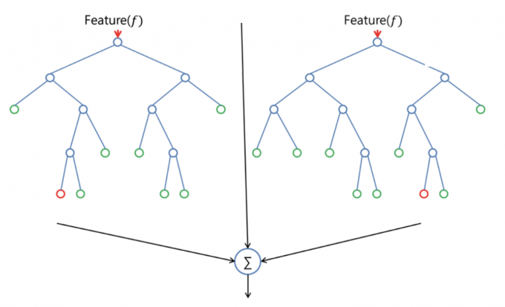
Random Forest
Developed by Leo Breiman and Adele Cutler.
An ensemble method that groups multiple Decision Tree predictors.
A supervised learning algorithm that the "forest" it builds, is an ensemble of decision trees, usually trained with the “bagging” method.
Parallel processing.

Slide 9
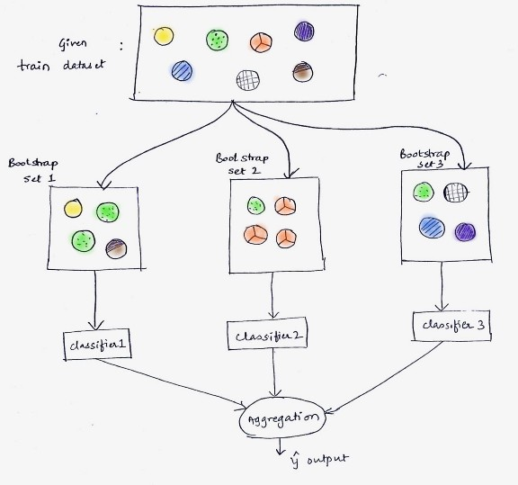
Random Forest Algorithm

Slide 10
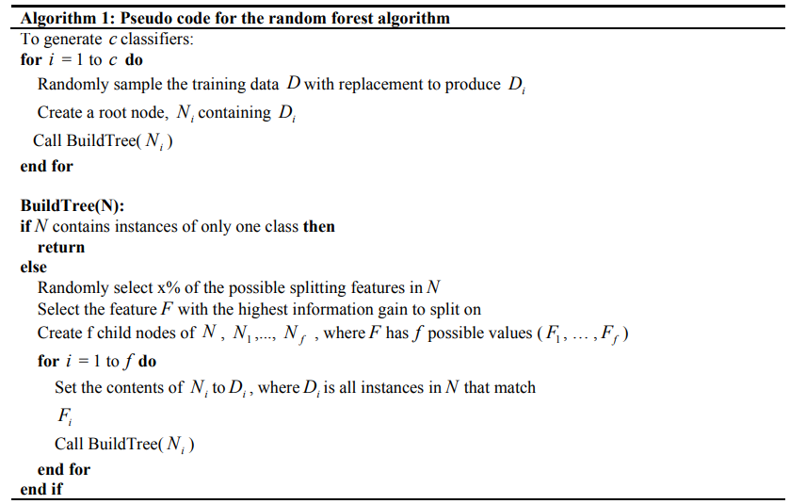
Random Forest Algorithm

Slide 11

Random Forest Algorithm

Slide 12
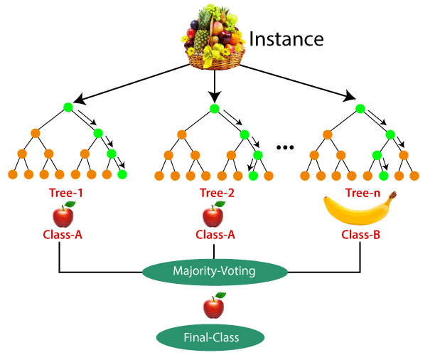
Random Forest Algorithm

Slide 13
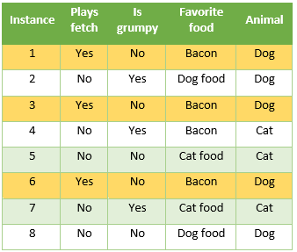
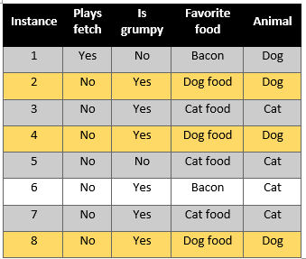
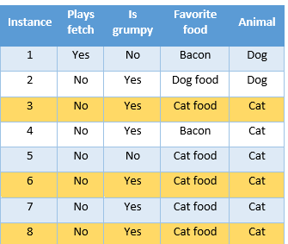




Random Forest Computation – Create Sub-Dataset
Dataset ($D$)
Insta-nce | Plays fetch | Is grumpy | Favorite food | Animal
1 | Yes | No | Bacon | Dog
2 | No | Yes | Dog food | Dog
3 | No | Yes | Cat food | Cat
4 | No | Yes | Bacon | Cat
5 | No | No | Cat food | Cat
6 | No | Yes | Bacon | Cat
7 | No | Yes | Cat food | Cat
8 | No | No | Dog food | Dog
Sub-Dataset ($D_{1}$) or Bag 1
Sub-Dataset ($D_{3}$) or Bag 3
Sub-Dataset ($D_{2}$) or Bag 2

Slide 14
Create Decision Tree for Each Sub-Dataset
Use Information Gain or Gini Impurity to Find the Root Node for Each Tree.
Do Decision Tree Procedure to Create Tree for Each Sub-Dataset.
Check the Created-Trees Performance
Training Error. Do the Test by Using the trained data, the ones included in Sub-Dataset
Prediction Error. Do the Test by Using the Out-of-Bag data, the ones not included in Sub-Dataset.
The final prediction result is obtained from majority vote from all Created-Trees results.

Slide 15

Random Forest Computation Demo

Slide 16
Boosting
Formulated by Yoav Freund and Robert Schapire in 1995.
A family of ensemble methods that are primarily used to reduce the bias of an estimator.
Boosting can be used in classification and regression tasks.
Boosting creates ensembles of homogeneous estimators.
Sequential processing.

Slide 17
AdaBoost
From Adaptive Boosting.
Two kinds of learner:
Weak learner (or weak classifier, weak predictor, and so on), is defined only as an estimator that performs slightly better than random chance, such as a decision tree with one or a small number of nodes.
Strong learner is defined as an estimator that is arbitrarily better than a weak learner.

Slide 18
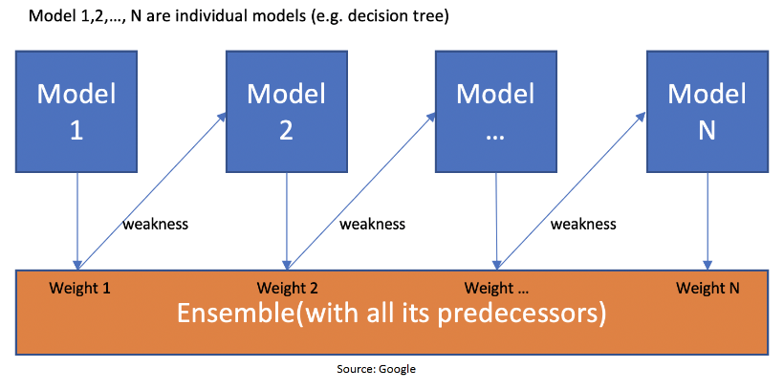
AdaBoost Mechanisme

Slide 19
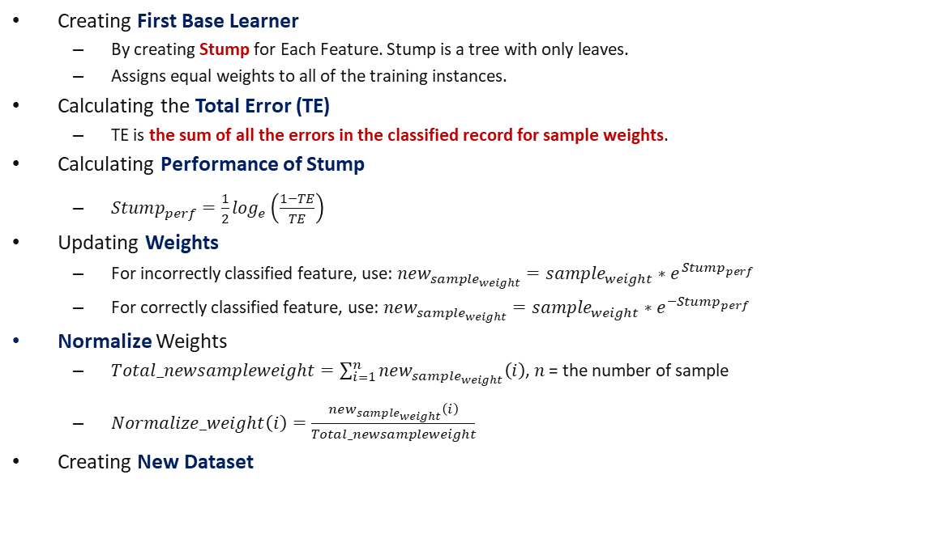
AdaBoost Algorithm
Creating First Base Learner
By creating Stump for Each Feature. Stump is a tree with only leaves.
Assigns equal weights to all of the training instances.
Calculating the Total Error (TE)
$\text{TE} \text{is} \text{the} \text{sum} \text{of} \text{all} \text{the} \text{errors} \text{in} \text{the} \text{classified} \text{record} \text{for} \text{sample} \text{weights}$.
Calculating Performance of Stump
$Stump_{perf}=\frac{1}{2}\log_{e}\left(\frac{1−TE}{TE}\right)$
Updating Weights
For incorrectly classified feature, use: $new_{sample_{weight}}=sample_{weight}∗e^{{Stump}_{perf}}$
For correctly classified feature, use: $new_{sample_{weight}}=sample_{weight}∗e^{{−Stump}_{perf}}$
Normalize Weights
$Total_newsampleweight=\sum_{i=1}^{n}{new_{sample_{weight}}\left(i\right)}$, $n$ = the number of sample
$Normalize_weight\left(i\right)=\frac{new_{sample_{weight}}\left(i\right)}{Total_newsampleweight}$
Creating New Dataset

Slide 20
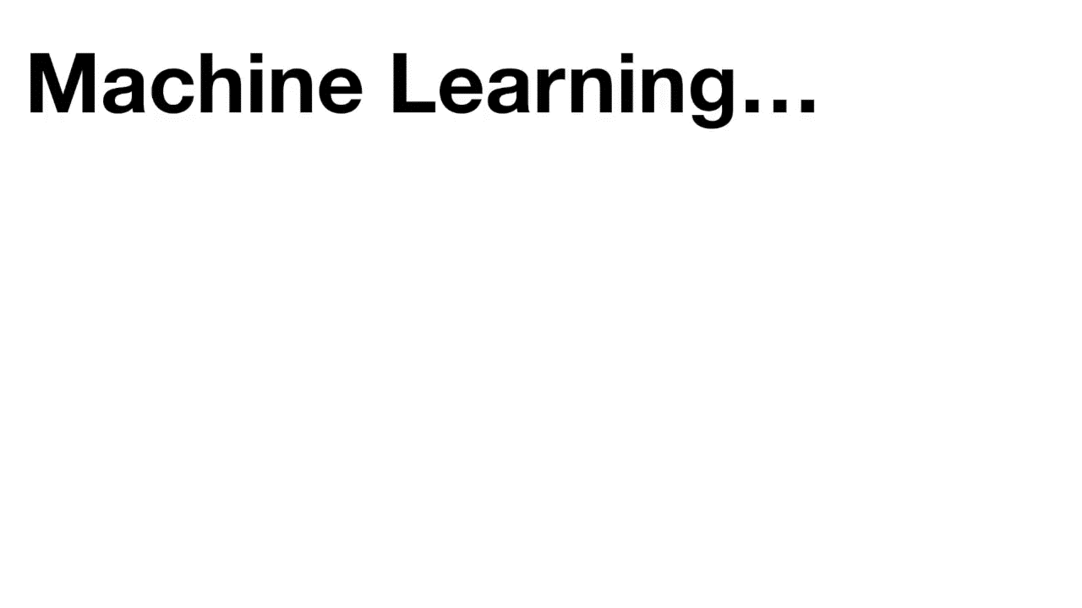
AdaBoost Computation

Slide 21
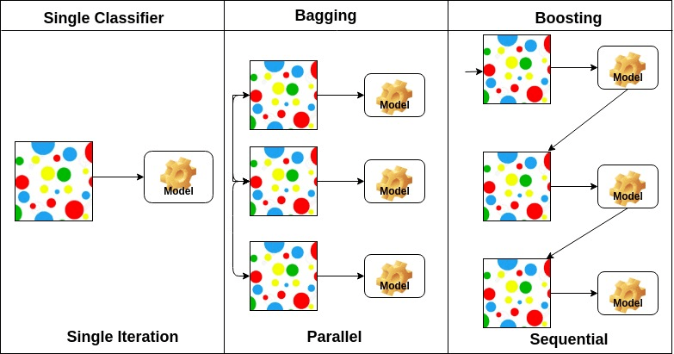
Classifier Difference

Slide 22
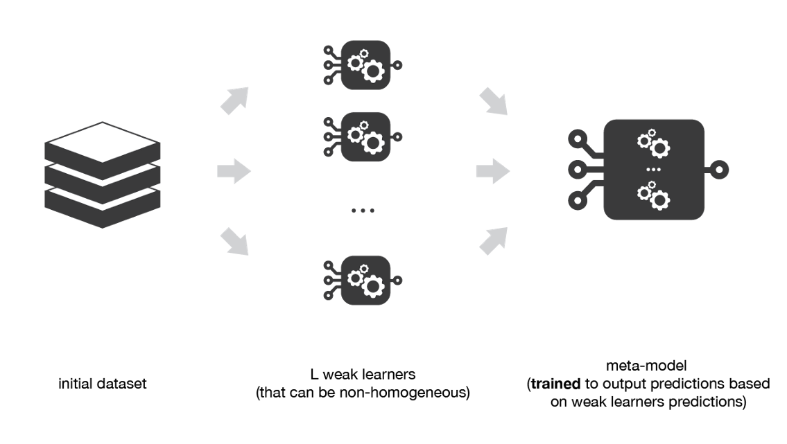
Stacking
Heterogeneous weak learners, different learning algorithms are combined.
Learns to combine the base models using a meta-model.
Parallel processing.

Slide 23
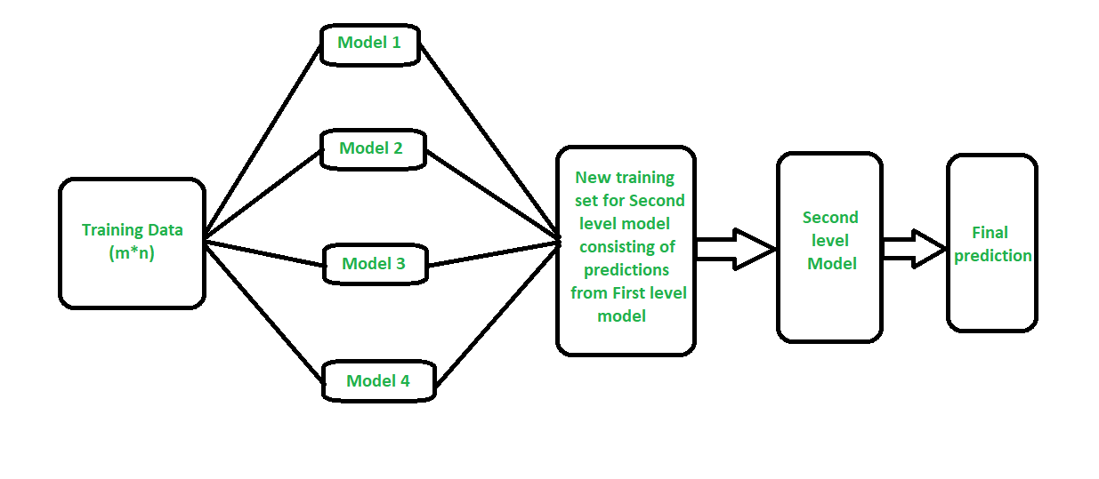
Stacking Architecture

Slide 24
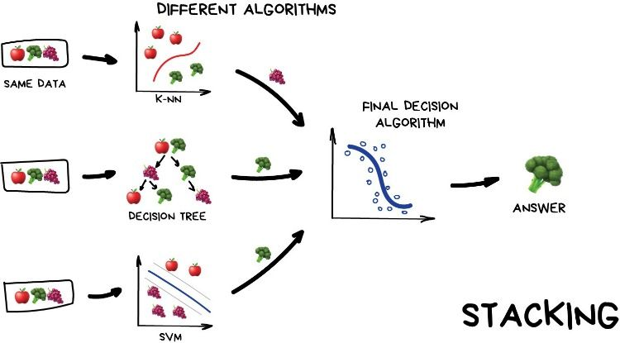
Stacking Example

Slide 25
Stacking Algorithm
Split the training data in two folds (training data and test data).
Choose L weak learners and fit them to data of the first fold.
For each of the L weak learners, make predictions for observations in the second fold.
Fit the meta-model on the second fold, using predictions made by the weak learners as inputs.

Slide 26
Homework
Person ID | Age | Income | Credit Rating | Buys Car
1 | 25-30 | High | Fair | No
2 | 25-30 | High | Excellent | No
3 | >40 | Medium | Fair | Yes
4 | >40 | Low | Fair | Yes
5 | 31-40 | Low | Excellent | Yes
6 | 31-40 | Medium | Excellent | Yes
7 | >40 | High | Excellent | Yes
Your jobs are:
Create Ensemble Method structure completed with all the manual computations using spreadsheet. The rule, student number:
1 – 8 use Bagging.
9 – 17 use AdaBoost.
18 – 26 use Stacking.
Create computer program for solving this problem using Python or combined with scikit-learn.
Do it yourself.
Do not plagiat.

Slide 27
Thank You for Today
Always Keep Your Spirit!

